Slide 1
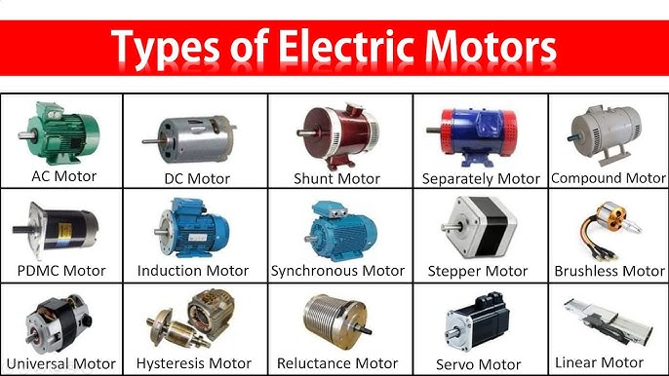
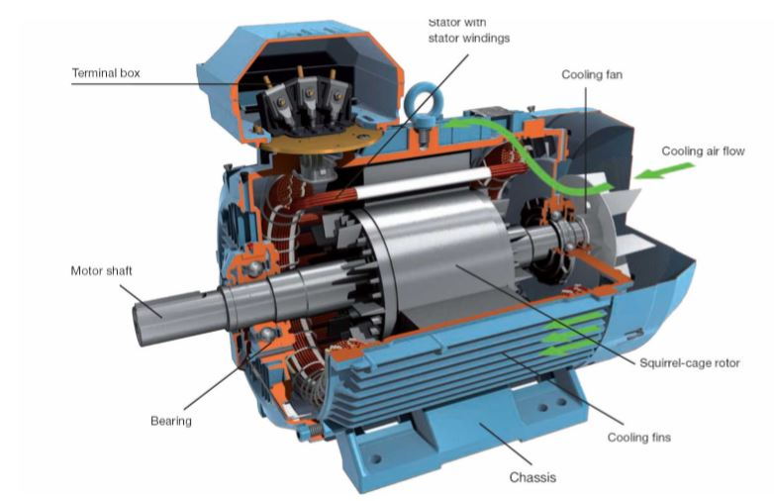
Motors (DC Motors & Servos)

Slide 2
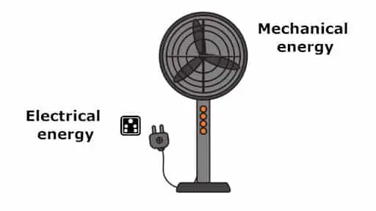
What is a motor?
A DC (direct current) motor is device used to convert electrical energy into mechanical energy.

Slide 3
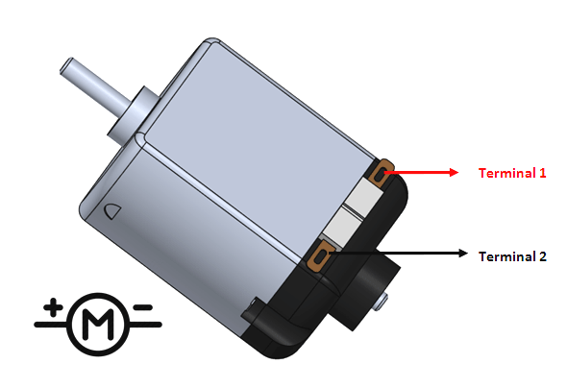
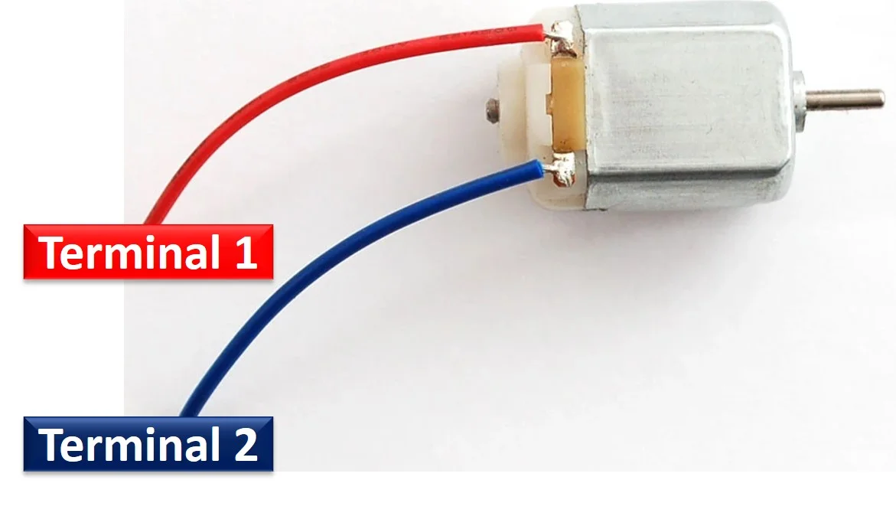
9V DC Motor Pinout

Slide 4
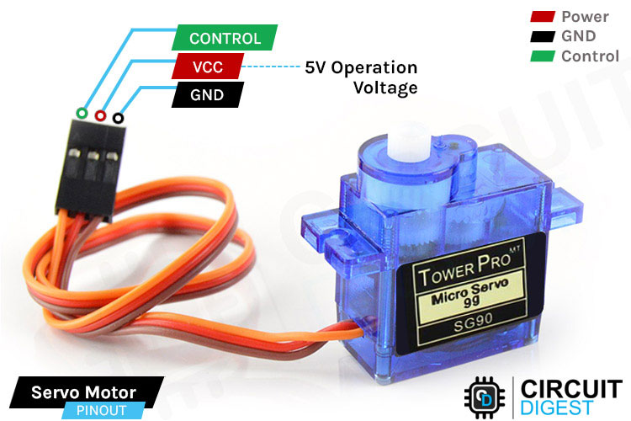
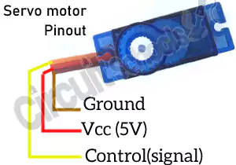
Servo Motor Pinout

Slide 5
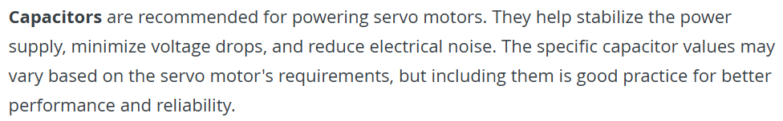
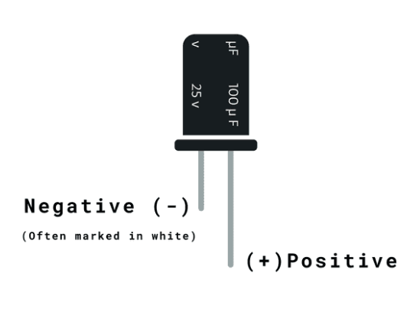
Brief Mention: Capacitors

Slide 6
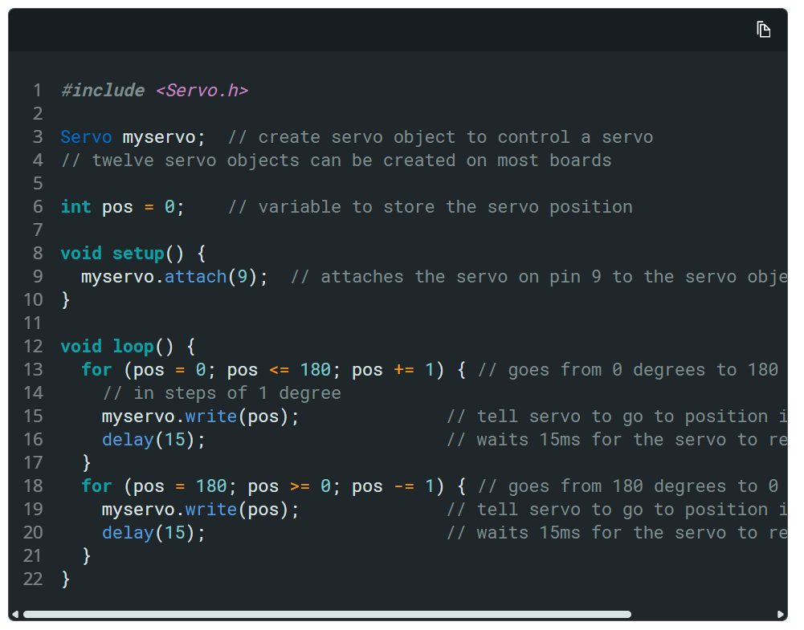
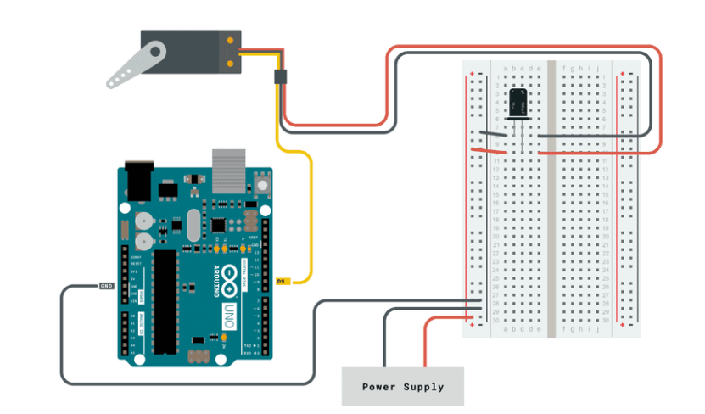
Servo Motor: Sweep Setup
Easy
Code is on the website! Click on the title :)

Slide 7
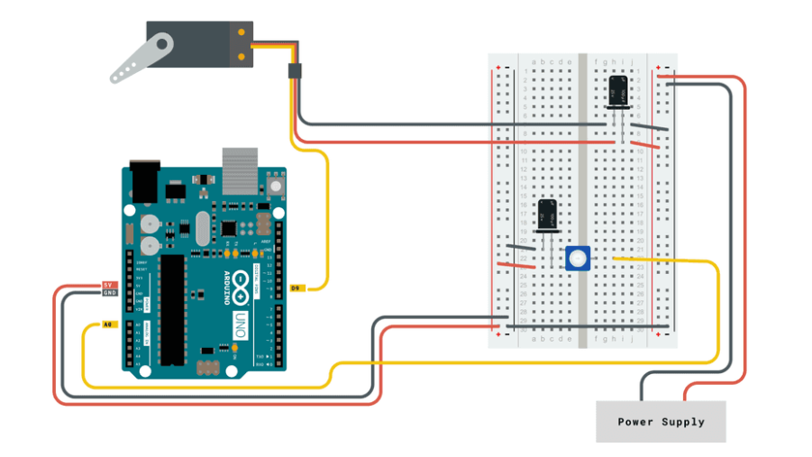
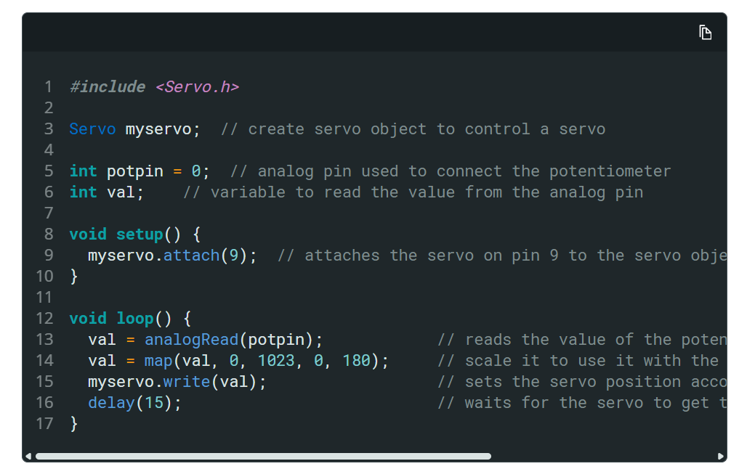
Servo Motor: Potentiometer Setup
Medium
Code is on the website! Click on the title :)

Slide 8
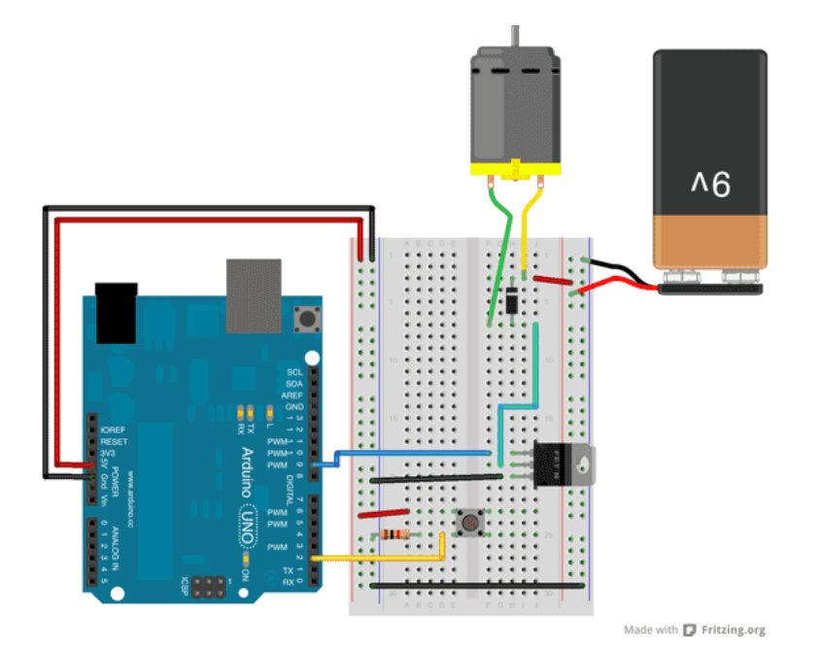
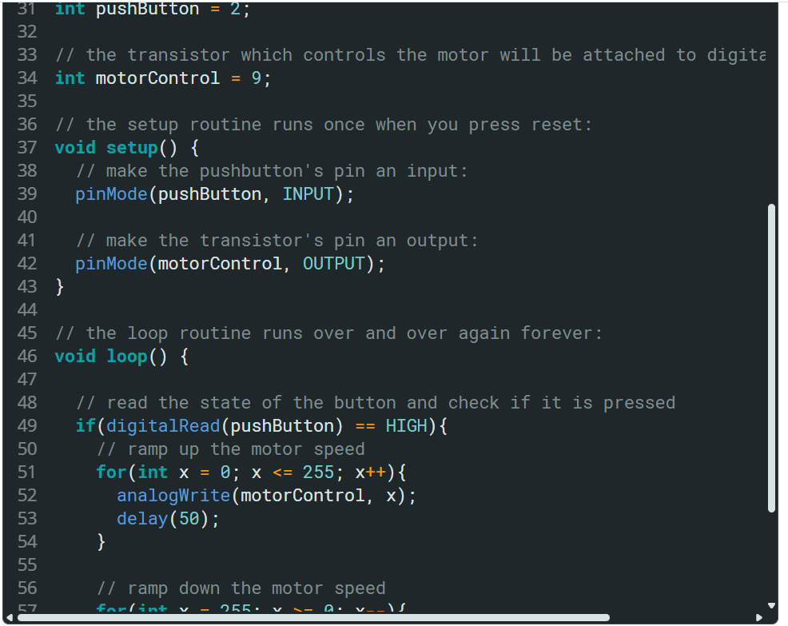
9V DC Motor: Button-Transistor Setup
Hard
Code is on the website! Click on the title :)

